Slide 1


Town Manager’s Proposed
FY22 Budget
January 7, 2021
Interim Town Manager
Samuel A. Finz

Slide 2

BUDGET ASSUMPTIONS
Limited use of FY 21 Actuals due to “COVID Economics”. Past data is less reliable as a predictor of future.
A “ whole lot of “ guesswork based upon “sound assumptions”
Town of Lovettsville in house accounting and reporting needs to be upgraded in FY22. Although Financial Audit indicates a strong financial base, new and more effective ways of accounting and reporting information needs to be addressed, especially during the COVID pandemic.
In FY22, the economies at the local, state and federal levels will still be recovering from “COVID Economics”
Town residents and businesses may continue to feel “pinch” and need subsidy in FY22
County provides a conservative estimate of Real Estate and Personal Property Tax Assessment figures suggesting an increase of only 3.28 percent on existing Lovettsville properties
Proposed Real Estate Tax Rate adjusted by “Roll Back” Rate as defined by County Assessment Office

Slide 3
BUDGET ASSUMPTIONS
County also assumes a more immediate slowdown in Commercial Business Operations and slow recovery in FY22
Housing and Population Figures indicate a significant slowdown in population and housing development in the Town. The slowdown will no longer provide a significant source of revenue as in the past.
The Town’s ratio of Commercial to Residential development remains low at only 5% of the Total. If this trend continues the residences in Town will continue to bear the full brunt of tax and fee increases in the future.
The Town Manager recommends a revised plan to stimulate economic development in the Town.
All Towns seek to acquire grants from the State and Federal Government. COVID Economics has shown us that such sources of funding may not be available in the future as in the past. Alternative sources of revenue are limited in the current year, and the TM assumes will continue to be limited in the near future.

Slide 4

ASSUMPTIONS (Cont’d)
Town fees are proposed to remain the same in FY22; Utility Fees are proposed to stay the same, however there will soon need to be a rate study performed to evaluate current rates in relation to costs.
The Town has a substantial investment in Utility Operations. This investment should be maintained, and efficient services be provided.
The Town is facing aging facilities and underground lines. There will be more failures in the future and the Town must be ready to repair and replace equipment and facilities as required.
The Town has also invested in a new Facility and must recognize the increasing costs of maintenance and upkeep to protect its investment.
Economic leaders have kept interest rates low, to help families and businesses; however, this has kept returns on investment of funds relatively low with interest on savings in most cases below 1 percent. The Town needs to invest in its reserves by maximizing returns to the extent practicable while minimizing risks.

Slide 5
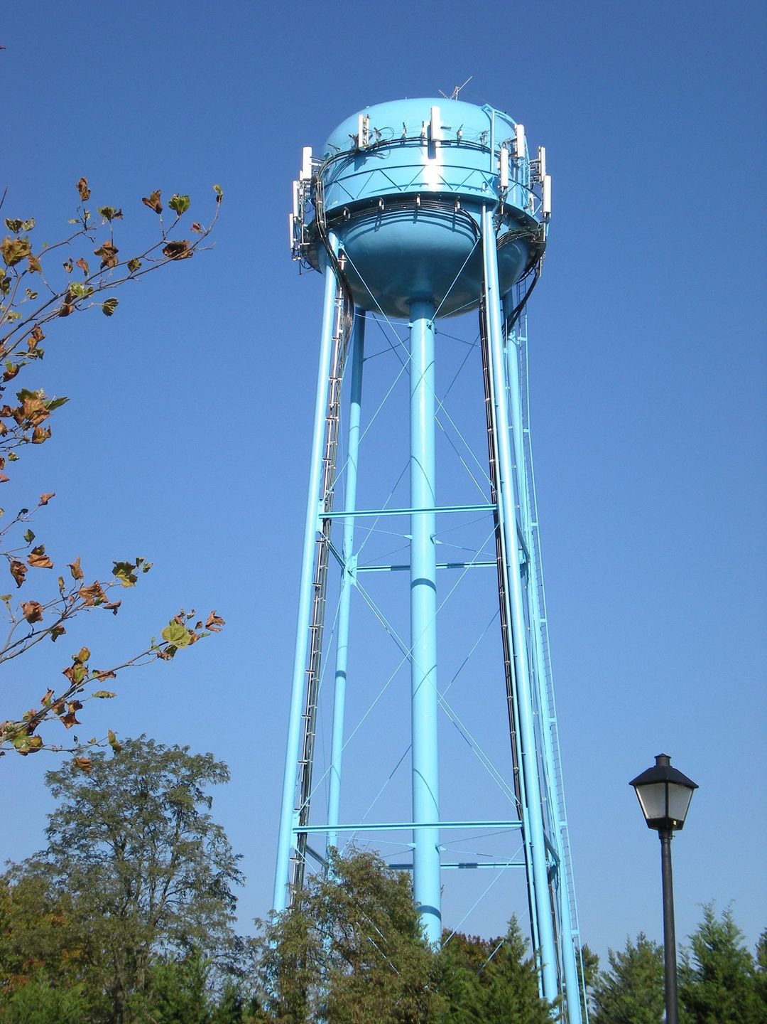
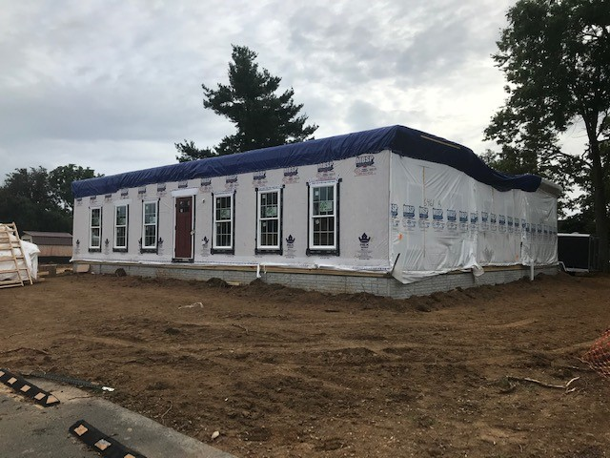
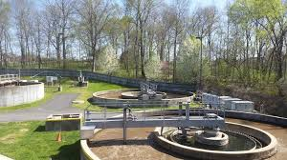
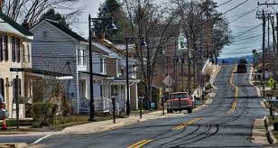
ASSUMPTIONS (Cont’d)
The Town has adopted a Financial Policy. In hard times it is less likely to be able to add to reserve balances and meet Financial Policy guidelines. At the same time, this is not the time to deplete reserves.
While taking on additional debt is possible, the General and Utility Funds are not in a position at the present time to absorb increase debt service costs and therefore capital improvement in the immediate future should be limited strictly to need and affordability.
TM Assumed a maximum 3% combined COL and performance increase in salaries
TM proposed one additional P/T position, abolished ATM position, reclassified several positions, created PT positions from FT positions at limited hours, will hire new TM in FY22, maintaining personnel costs overall, using some FY21 savings from personnel related modifications, reassignments, and reclassifications.

Slide 6
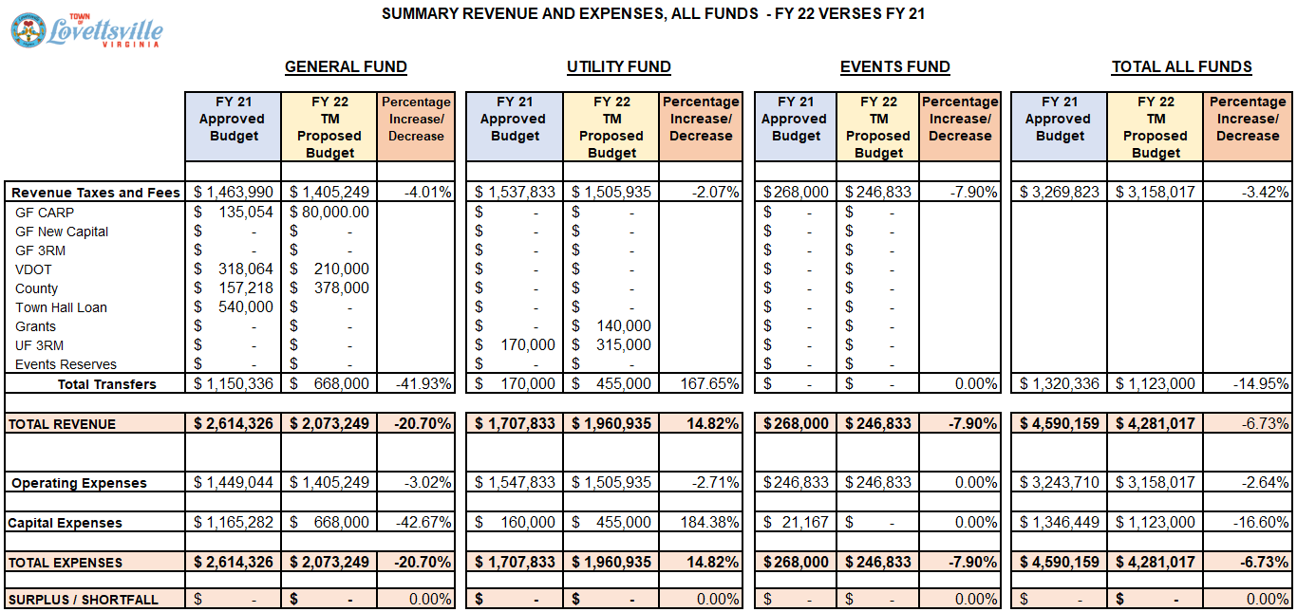

Slide 7













TAX BASE
$360.388 MIL
TO
$378.874 MIL
PLUS 3.20%
TAX RATE
$ 0.184
$ 0.178
RESIDENTIAL
95%
-3.0%
BUDGET
HIGHLIGHTS
COMMERCIAL 5%
GF TAXES
& FEES
$1,463,990
$1,405,249
GF
$2,614,326
$2,073,249
UF
$1,707,833
$1,960,935
EF
$268,000
$246,833
-4.01%
-20.7%
+14.8%
-7.90%
GF CAPITAL EXPENSES
$1,165,282
$668,000
STAFFING BUDGET
$743,337
$752,603
1 ADDT’L
PART TIME
TOTAL
BUDGET
$4,590,159
$4,281,017
-42.67%
+ $9,266
-6.73%

Slide 8
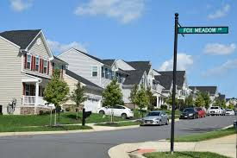

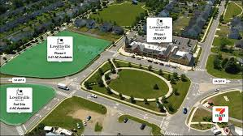
Maintained GF and UF Fees throughout FY22
UF Overhead Transfer from GF to support Utility Operations equals 11.2% of Total Utility Fund Expenditures
Debt Service Ratio Limits per Town’s Financial Policy is 15%;
    GF Debt Service Ratio 6.42%
    UF Debt Service Ratio 18.82%
Increase in future Household Projection is quite limited to 2 Additional Units, indicating Slow Growth in Residential Development, and zero Growth in Commercial Industrial Development in FY22
In FY22 it is Projected that the Total Number of Households will Increase to 836 Households
Estimated Population may Increase from 2,827 to 2,834 (Does not include 2020 Census Figures)
BUDGET
HIGHLIGHTS (Cont’d)

Slide 9
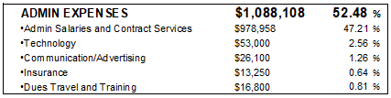







HOW YOUR GF DOLLAR IS SPENT
TOTAL $2,073,249

Slide 10


REAL ESTATE ASSESSMENT
& PROPOSED TAX RATE
The Real Estate Tax Rate applied to the assessed value of each individual property (provided by the County Assessment Office to each Property Owner) equals the Annual Re-Tax paid. Property owners pay ½ the tax twice a year in Loudoun County.
When property assessments increase in the County, and the property tax rate stays the same as in the prior year, property owners will pay more tax to the Local Jurisdiction.
Property owners usually enjoy the perceived benefit of the increase in the value of their property, but usually don’t like the idea of paying more taxes to the local jurisdiction.
TAX
&
FEES

Slide 11
REAL ESTATE ASSESSMENT
& PROPOSED TAX RATE
So that the property owner does not have to bear this increase, jurisdictions like Lovettsville can offset the increase in the tax payment, by “rolling back” the tax rate by an equivalent percentage.
As a result, the tax rate can be reduced by the local jurisdiction and is usually a decision made by the Town Council upon adopting the Fiscal Year Budget.
The Town Manager, in preparing his/her Proposed Budget can recommend that this action be taken in setting the Tax Rate.
TAX
&
FEES

Slide 12
REAL ESTATE ASSESSMENT
& PROPOSED TAX RATE
The Approved Tax rate in FY21 is $0.184 per $100 of Assessed Value. The Town Manager proposes a “roll back” of that rate to $0.178 per $100 of Assessed Value.
This “roll back” will have the effect of “equalizing” the Tax Rate and the taxes that each property owner will pay.
In addition to rolling back the rate, the Town Council can either decrease further, or even increase the rate based upon many other factors based on the Budget.
The Town Manager’s Budget does not recommend any further decrease or increase in FY22 in the Property Tax Rate
TAX
&
FEES

Slide 13
REAL ESTATE ASSESSMENT
& PROPOSED TAX RATE (Cont’d)
The Calculation of the Roll Back Tax in the FY22 budget is as follows:
The Total Real Estate Tax Assessment of properties in Lovettsville for FY21 as of November 30, 2020 from the County Preliminary Assessment Report is $378,874,350
Multiply the current Lovettsville rate of $0.184/ $100,
the Total Lovettsville Tax Revenue would have been $697,129.
The increase in Assessments in Lovettsville for existing Properties is 3.28 %
Using a “roll back” rate of $0.178 applied to the same tax base the Total Lovettsville Tax Revenue for commercial and residential properties is $674,396, a reduction in Property Tax Revenue in FY22 of $22,733
Strictly for purposes of analysis, using the 2021 Total Assessed Value of $378,874,350, a full one cent increase in the tax rate equates to $37,887
TAX
&
FEES

Slide 14

HOUSING AND POPULATION PROJECTIONS

Slide 15
HOUSING AND POPULATION PROJECTIONS

Slide 16
HOUSING AND POPULATION PROJECTIONS

Slide 17


STAFFING SUMMARY
Current Staffing
Town Manager
Assistant Town Manager/ Clerk
Town Treasurer
Director of Planning (Hrly)(PT)
Project Manager
Customer Service /Acct.
Utility Director
Chief Utility Operator
Utility Operator
Plant Operator
Instrumentation Technician (Hrly) (PT)
Plant Operator (Hrly) (PT)
Public Works (Hrly) (PT)
Proposed Staffing
Town Manager
Town Clerk
Town Treasurer
Director of Planning
Project Manager (Hrly) (PT)
Accountant
Utility Director
Chief Utilities Operator
Utility Operator
Plant Operator
Instrumentation Technician (Hrly)(PT)
Plant Operator (Hrly)(PT)
Public Works (Hrly)(PT)
Customer Services Rep (New)(Hrly) (PT)
13 Total : 9-FT and 4-PT
FY 21 Approved Budget $743,337
FY 21 Estimated Actual $770,000
Note: Includes Salaries for Former
TM + ITM
14 Total: 8-FT 6-PT
FY22 Proposed Budget $752,603
Note: Includes New TM, Plus
Additional P/T Cust. Services
Rep. and Elimination ATM
Position

Slide 18

CONCLUSIONS
The Town Manager Recommended FY22 Budget is a Balanced Budget
The Town Council over the course of the next several weeks will meet in workshop settings to discuss the Budget.
The Town Council will be expected to ask questions of the TM and Staff; and in turn they will provide Town Council input toward the goal of completing the Budget cycle in a timely manner and adopting the Town Council’s FY22 Budget in late March 2021.
The Town Manager’s Proposed Budget is a starting point.
However, before proceeding, the Town Manager recommends that the Town Council set budget priorities and establish reasonable assumptions, where a consensus can ultimately be reached for adopting the Town Council’s FY22 Budget.

Slide 19
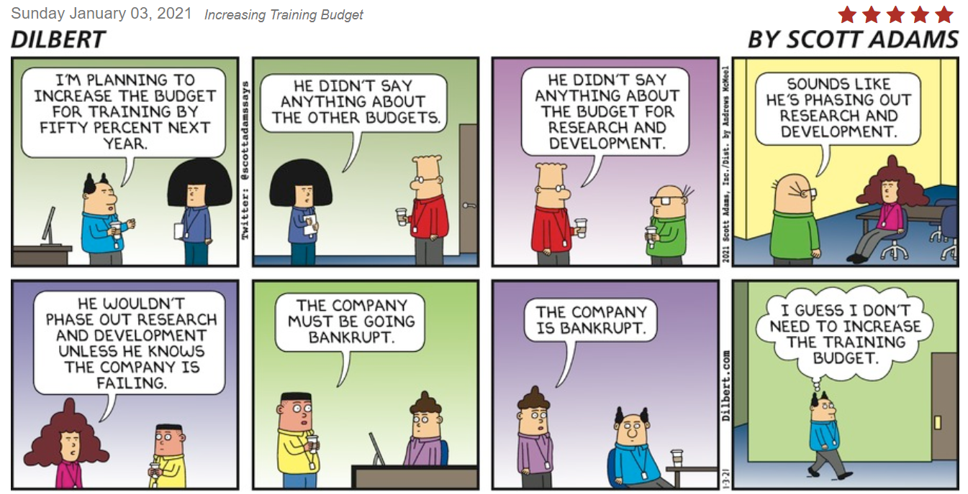
https://dilbert.com/strip/2021-01-03?utm_source=dilbert.com/share-email&utm_medium=email&utm_campaign=brand-loyalty

Slide 20


FY 22 BUDGET and CIP SCHEDULE
January 21 Budget Work Session
(FY22 General Fund Operating and Capital Budget and Schedule of Fees, Events Committee Structure)
February 4 Budget Work Session
(FY22 Utility Fund Operating and Capital Budget and Schedule of Fees, FY22 Events Fund Budget)
February 11 Budget Ad Sent To Newspaper
February 25 Budget Ad Published In Newspaper
(for Not-to-Exceed FY22 Operating and Capital Budget and Schedule of Fees)
February 25 Additional Budget Work Session
(if necessary)
March 11 Public Hearing
(Town Council Proposed FY22 Operating and Capital Budget and Schedule of Fees)
March 25 Adopt FY22 Budget and CIP
(Operating and Capital Budget and Schedule of Fees.
Submit Real Estate Tax Rate to County following budget adoption—due by April 1 annually)

Slide 21
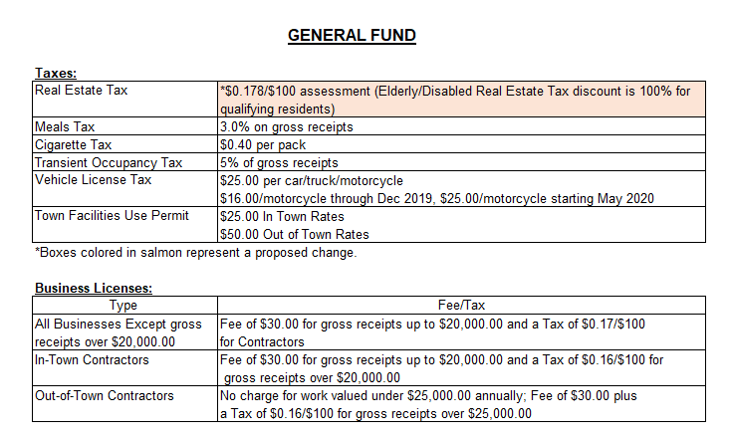
FY22 TM PROPOSED SCHEDULE OF FEES

Slide 22
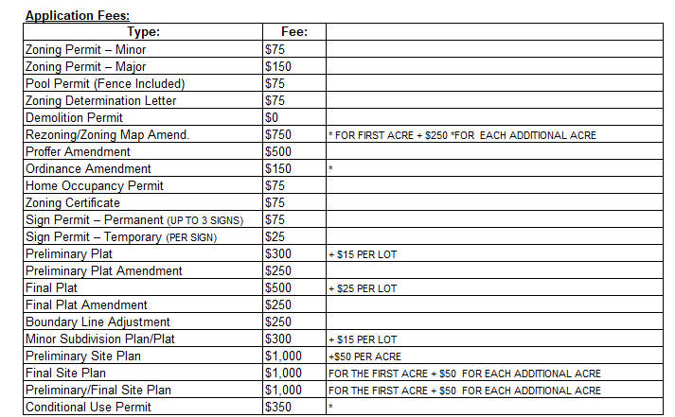
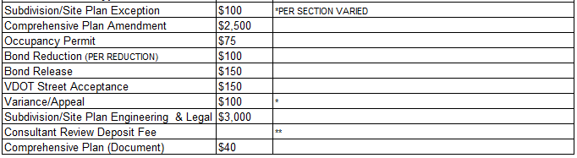
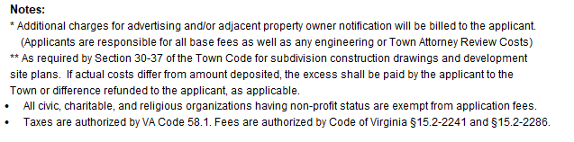


Slide 23
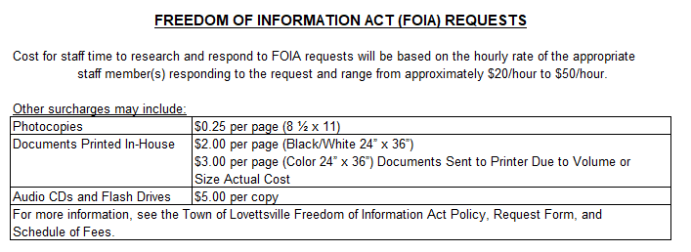
FY22 TM PROPOSED SCHEDULE OF FEES

Slide 24
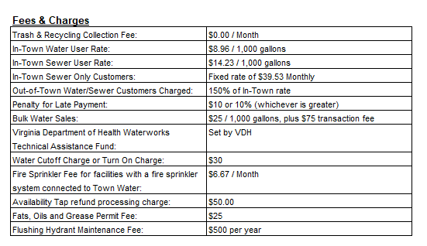
FY22 TM PROPOSED SCHEDULE OF FEES
UTILITY FUND

Slide 25
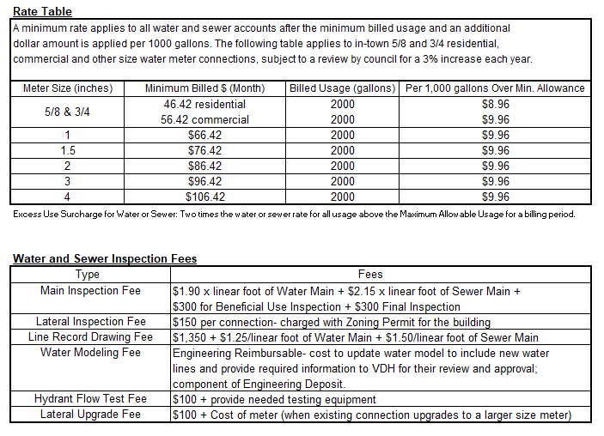

Slide 26
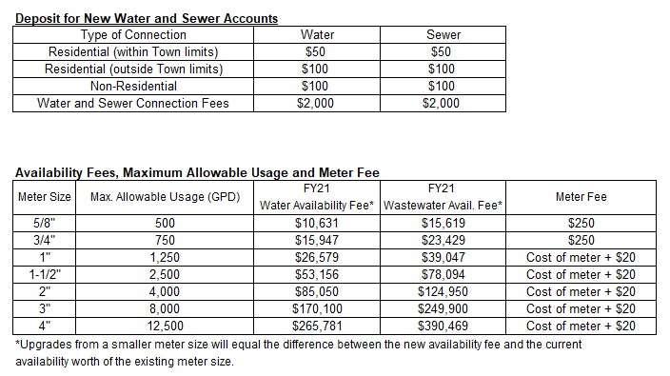
SCHEDULE OF FEES (Cont’d)

Slide 27
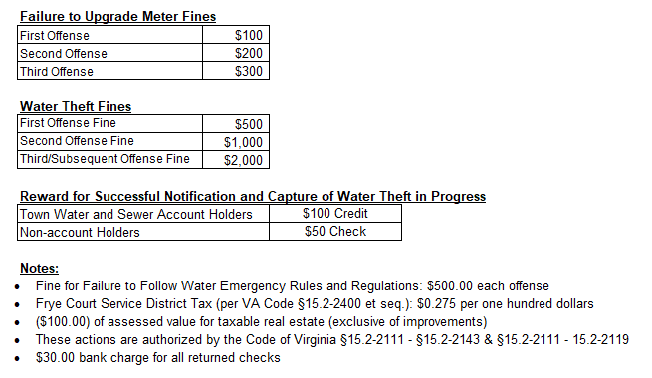
SCHEDULE OF FEES (Cont’d)

