Slide 1
S. Loudoun and Locust Street Improvements, Preliminary Engineering
Lovettsville, Virginia May 10, 2022

Slide 2
Agenda
Alternatives
Traffic Analysis Summary
Concept Plans
Costs
Recommendations
Questions

Slide 3
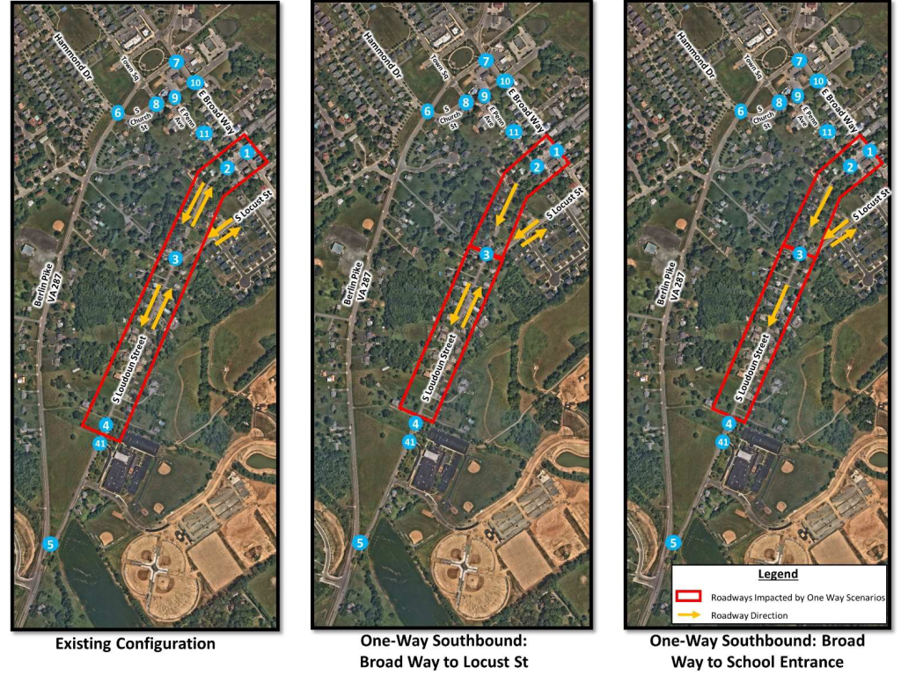
Alternatives:
Town Council directed three alternatives be analyzed for feasibility:
Concept 1 – (Existing Conditions) – 2-way operations on S. Loudoun St with sidewalk and curb and gutter on the east side of the roadway
Concept 2 – 1-way SB operation of S. Loudoun St from E Broad Way to S Locust St. 2 – way operation of S Loudoun St from S Locust St to Berlin Tpk with sidewalk and curb and gutter on the east side of the roadway
Concept 3 – 1-way SB operation of S. Loudoun St from E Broad Way to northern Elementary School Entrance. Sidewalk and curb and gutter on the east side of the roadway

Slide 4
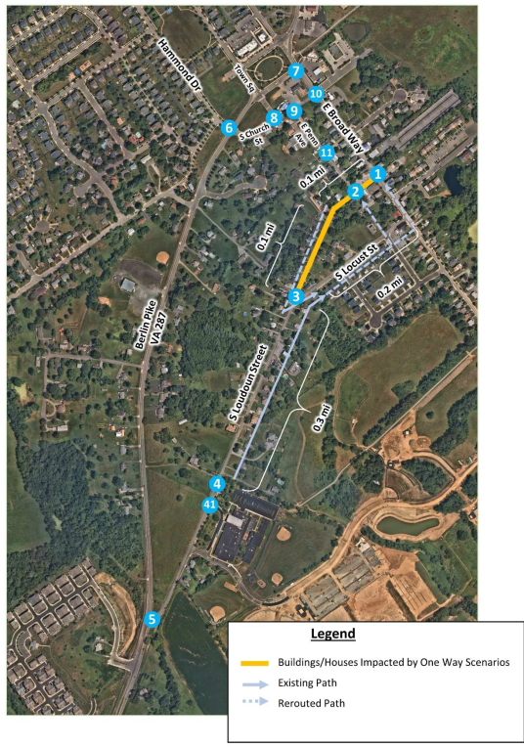
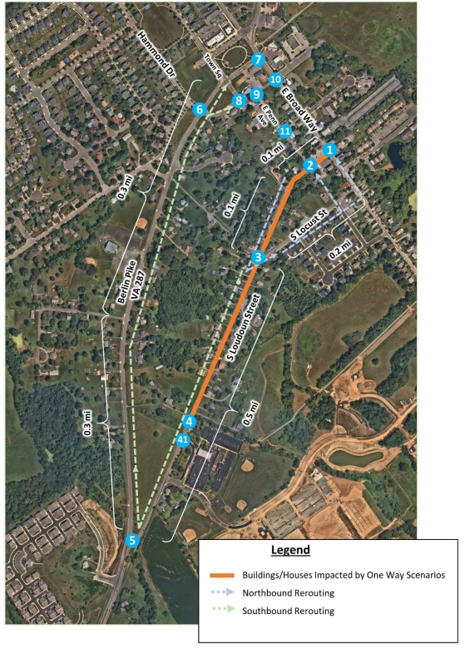
Traffic Analysis Summary:
Traffic data collected at 11 intersections.
Results found that either one-way configuration could be implemented with minimal impacts to study area intersections.
Concept 2 - 0.4 miles of re-routing travel
Concept 3 - would require significant re-routing of existing residential – 1.3 miles of travel
Concept 2 Preferred due to minimal impacts to study area intersections (all operate at acceptable LOS) and minimal re-routing

Slide 5
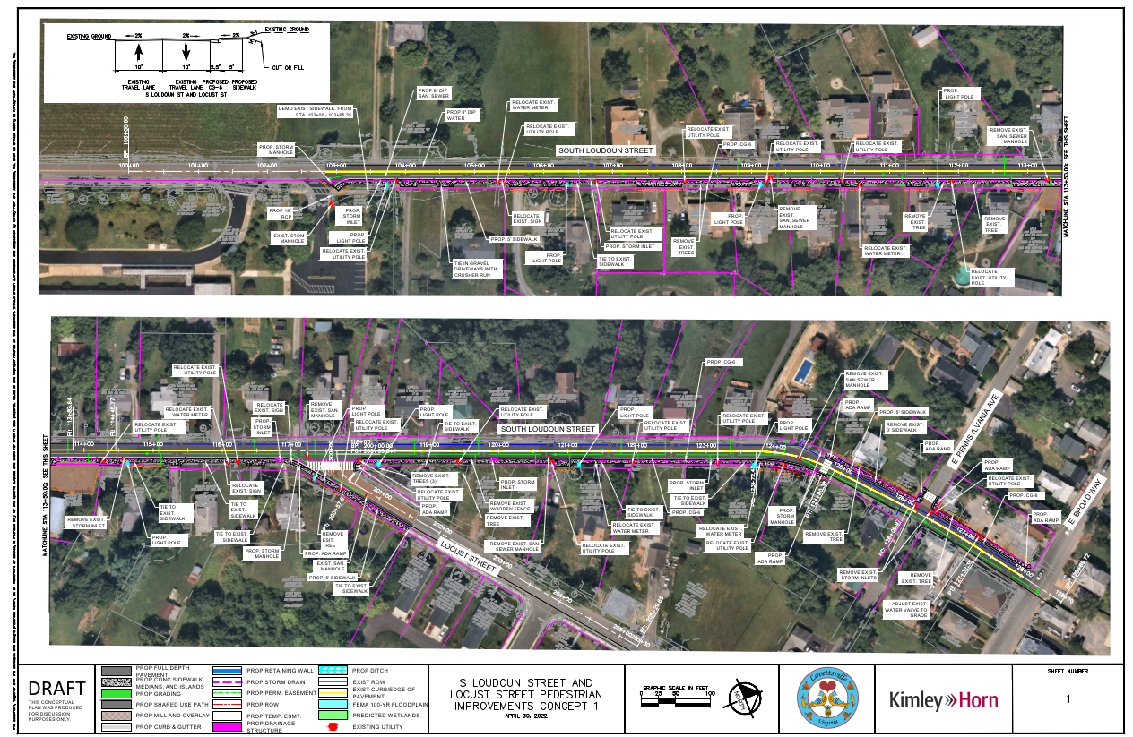
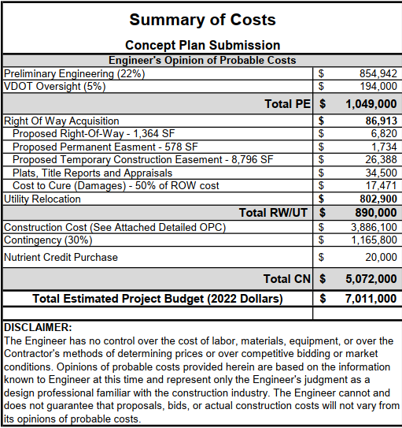
Concept Plans: Concept 1 Two-Way S Loudoun St
Two-10’ Lanes
5’ Wide SW with no Grass Buffer Strip
Curb and gutter with Drainage improvements
Lighting, Sanitary, and Waterline Upgrades
Pros:
Maintains Existing Travel Patterns
Provides pedestrian network
Cons:
Requires additional ESMT and ROW
Additional Property Impacts due to width of improvements
Additional cost due to property and easement needs

Slide 6
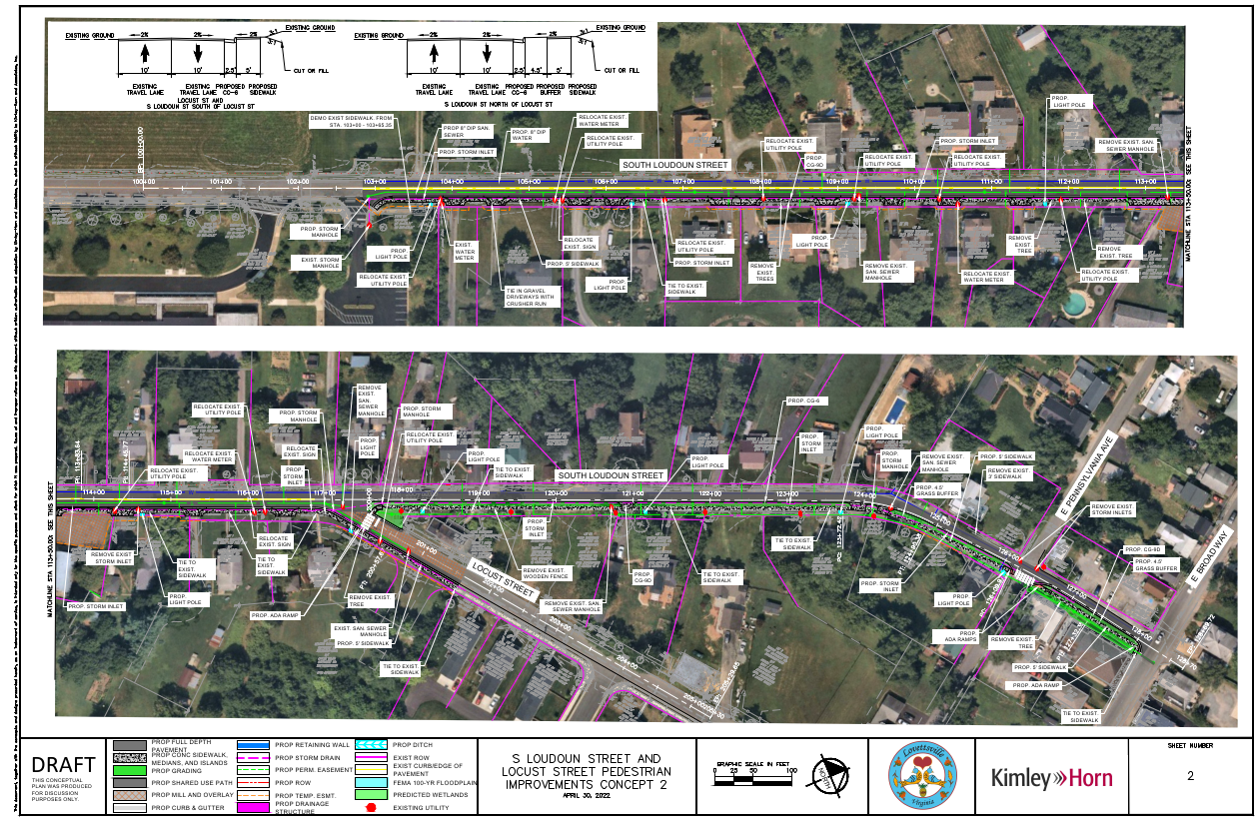
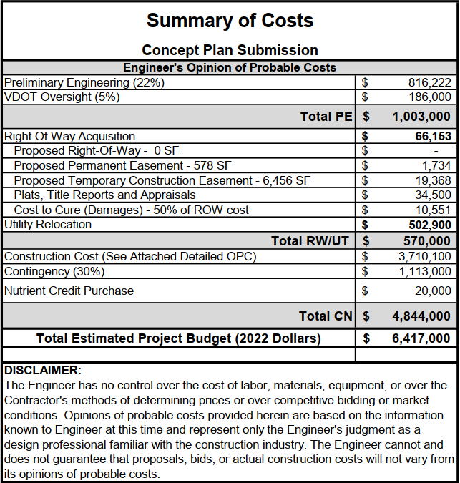
Concept Plans: Concept 2 One-Way S Loudoun St (Broad Way to Locust)
Two-10’ Lanes/One-10’ Lane for One Way operations
5’ Wide SW with Grass Buffer Strip
Curb and gutter with Drainage improvements
Lighting, Sanitary, and Waterline Upgrades
Pros:
Provides pedestrian network
Grass buffer strip (S Locust to E Broad Way)
Minimizes ESMT and ROW needs in the narrowest section of the corridor
No ROW Required
Cons:
Requires additional ESMTs as compared to Concept 3
Minor re-routing due to one-way pattern

Slide 7
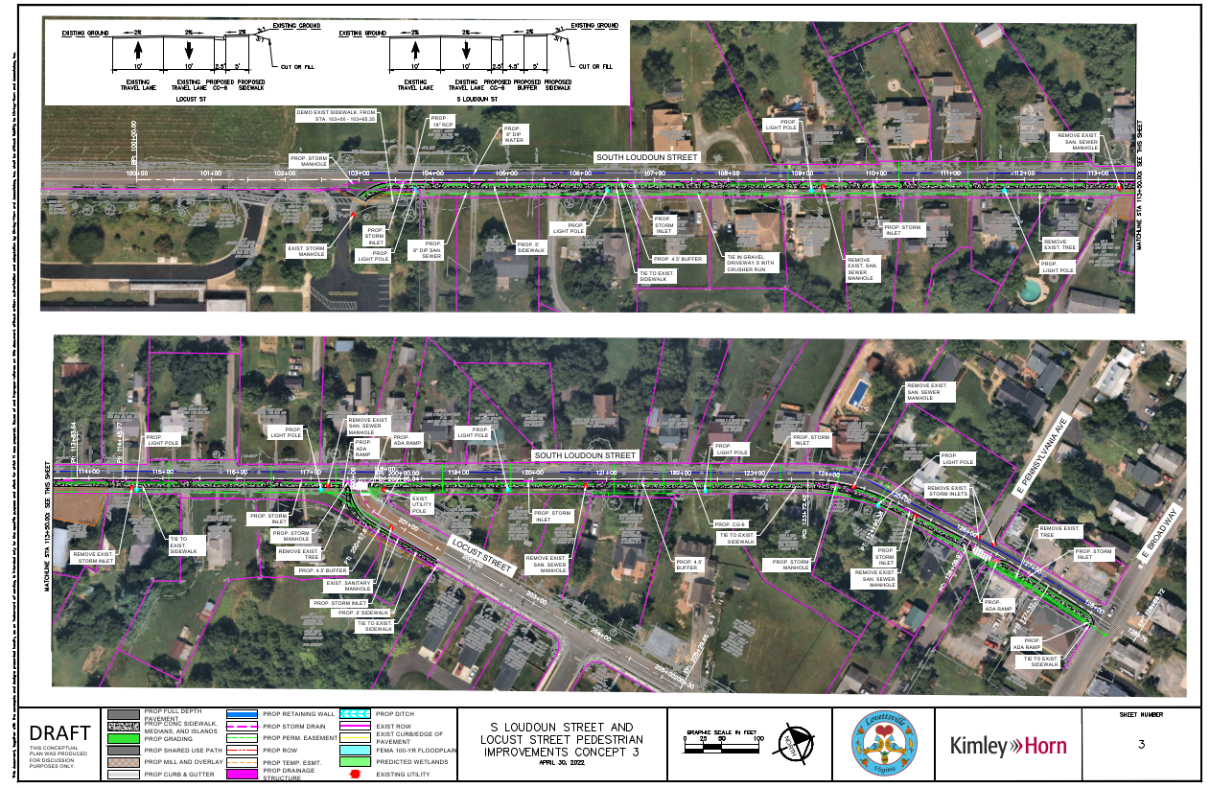
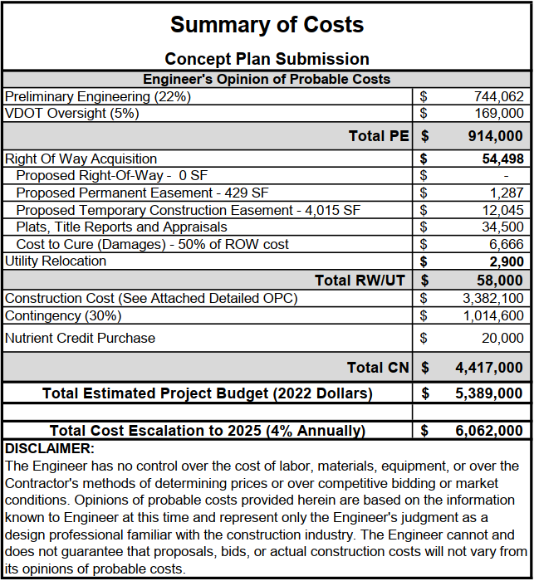
Concept Plans: Concept 3 One-Way S Loudoun St (Broad Way to Lovettsville Elementary)
One-10’ Lane for One Way operations
5’ Wide SW with Grass Buffer Strip
Curb and gutter with Drainage improvements
Lighting, Sanitary, and Waterline Upgrades
Pros:
Provides pedestrian network
Grass buffer strip Minimizes ESMT and ROW needs in the narrowest section of the corridor
No ROW Required
Cons:
Major re-routing due to one-way pattern for all of S Loudoun St

Slide 8
Recommendations
Concept 2 is the preferred alternative and an engineering recommendation based on the traffic study, conceptual design plans, and cost estimate.
Utilizes existing ROW, and makes use of one-way operations in the narrowest portion of the corridor
Requiring minimal re-routing of existing residents with minimal impact on traffic operations
Balance of reduced cost while providing needed pedestrian improvements.

Slide 9
Questions?

